Slide 1
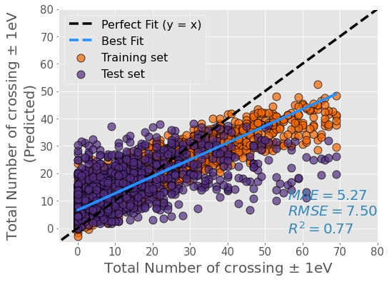
13 PCA Features

Slide 2
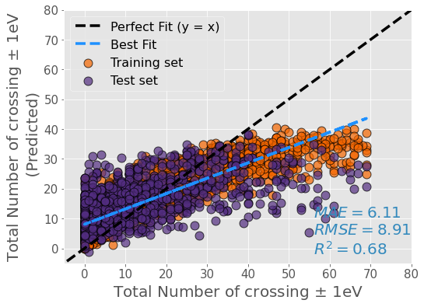
18 PCA Features

Slide 3
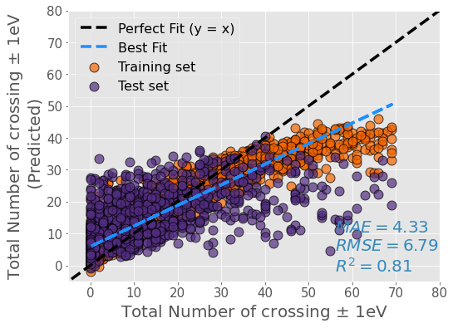
25 PCA Features

Slide 4
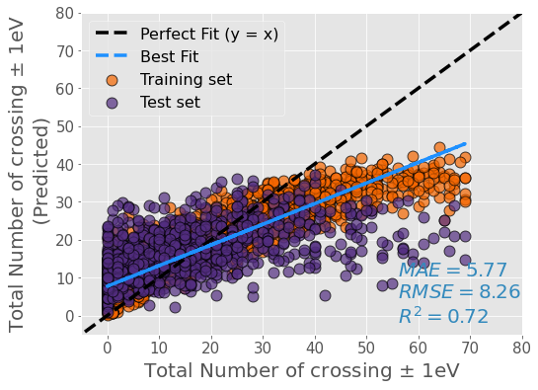
35 PCA Features

Slide 5
Using Robust Scaling

Slide 6
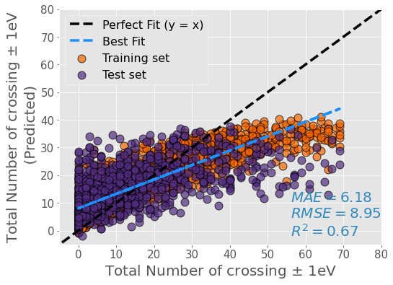
13 PCA Features
Standard Scaler
Robust Scaler

Slide 7
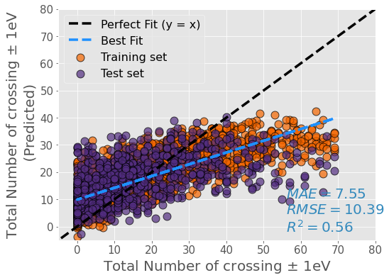
18 PCA Features
Standard Scaler
Robust Scaler

Slide 8
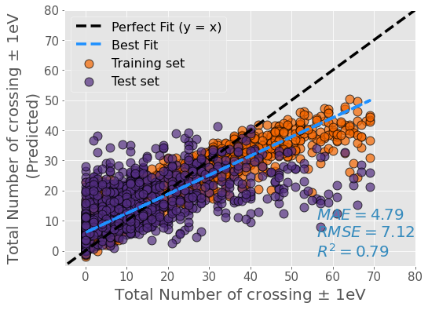
25 PCA Features
Standard Scaler
Robust Scaler

